Slide 1
Practical Investigation 5 Blue Garlic
Hi
I’m Leon
Hi
I’m Bailey
What makes garlic turn blue?
Hi
I’m Dea
Hi
I’m Marissa

Slide 2
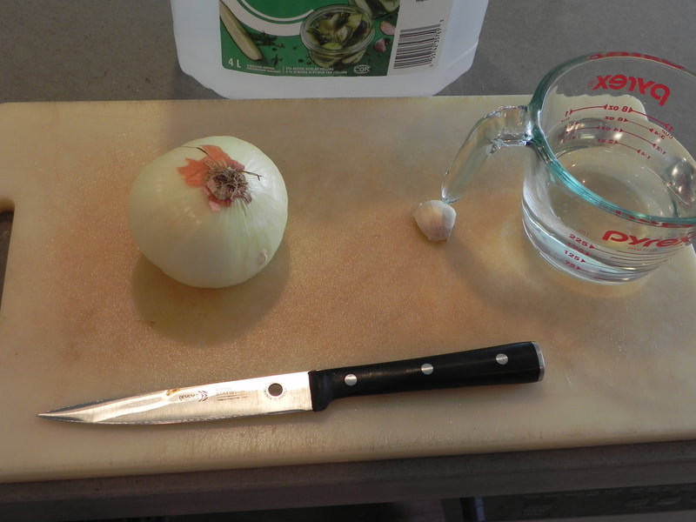
The Safety Guy says
Be careful with sharp knives!

Slide 3
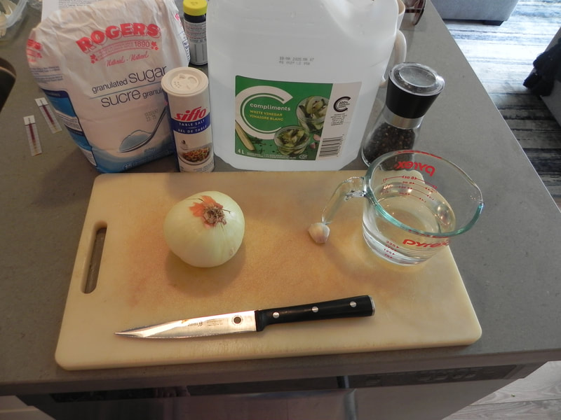
Be careful with Onions!
Why does cutting onions make you cry?

Slide 4
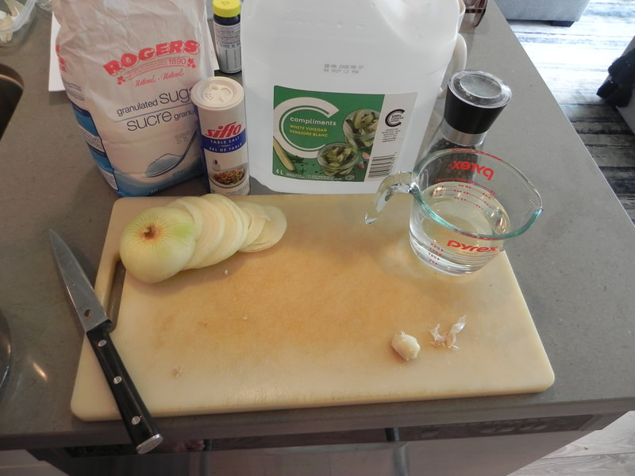

Slide 5
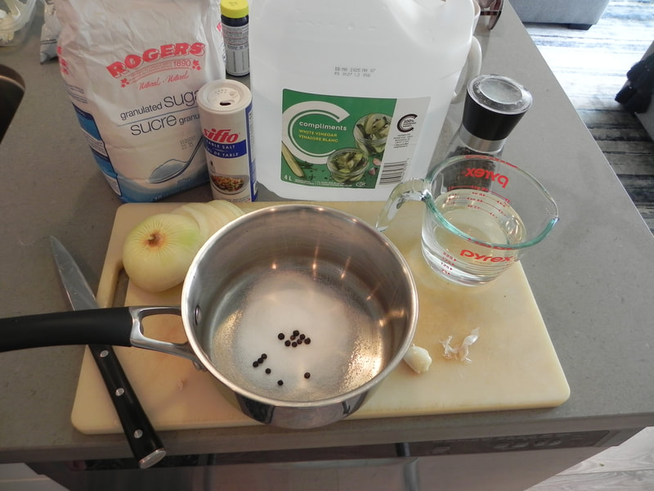

Slide 6
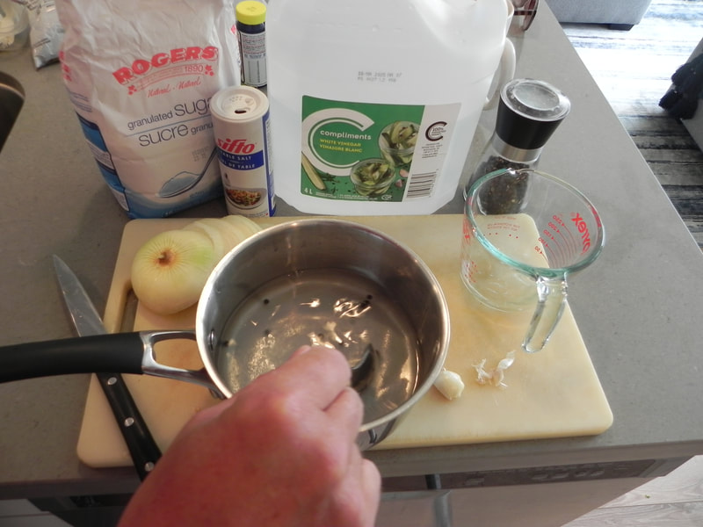
Vinegar is acidic!
What does acidic mean?

Slide 7
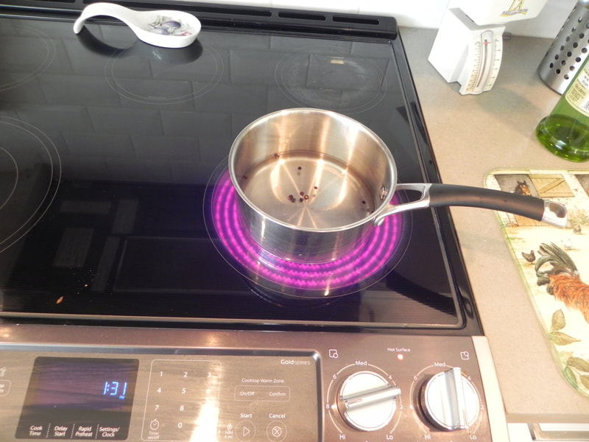
Be careful with Hot Stoves!

Slide 8
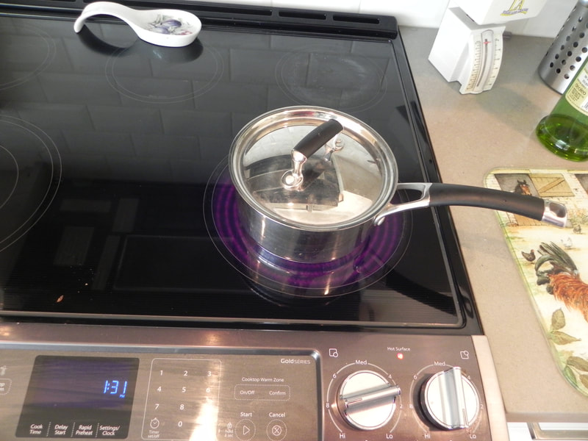
Why do we put the lid on?

Slide 9
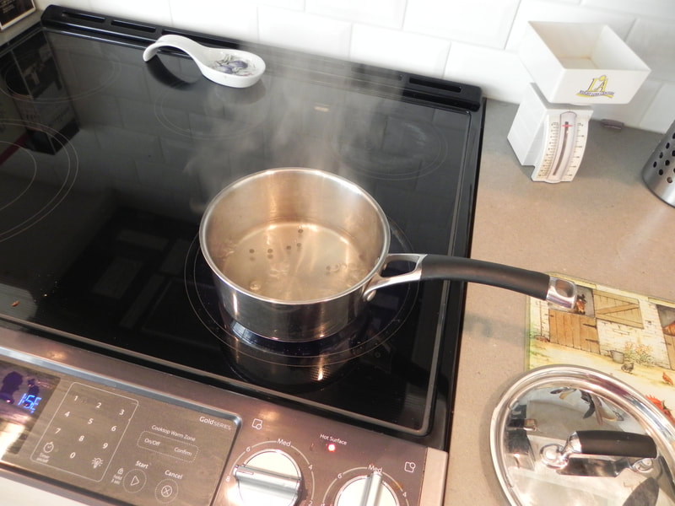
What is rising from the pot?

Slide 10
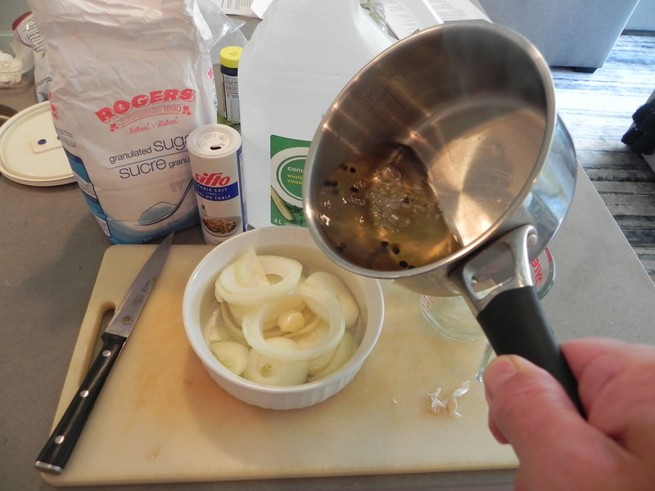

Slide 11
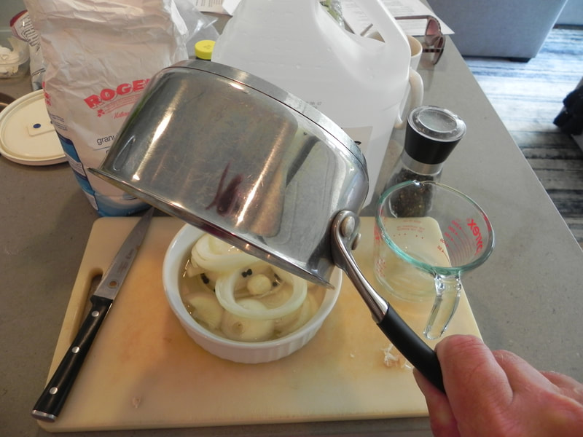
Be careful when pouring boiling liquids!

Slide 12
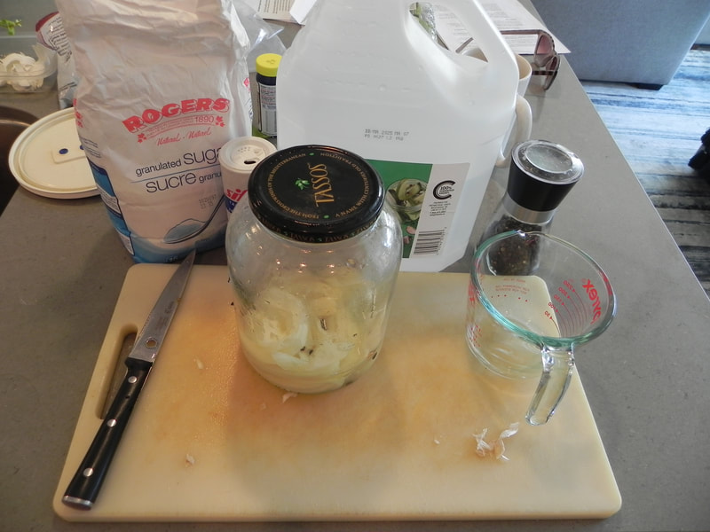

Slide 13
